Slide 1



Problem Definition and Design Thinking for Product Sale Analysis
In order to make strategic business decisions, it is crucial to analyze and understand sales trends and consumer behavior. Our Product Sale Analysis project aims to do just that using IBM Cognos. By defining analysis objectives, collecting sales data, designing relevant visualizations, and deriving actionable insights, we can help businesses achieve greater success.

Slide 2
Analysis Objectives
Identify Top-Selling Products 🏆
Analyze Sales Trends 📈
Determine which products are performing exceptionally well to further capitalize on their potential.
By identifying sales trends and patterns, businesses can more accurately plan for future growth and revenue goals.
Understand Customer Preferences 👥
Benchmark Performance 📊
Comparing sales performance within different time frames and product categories helps establish benchmarks and identify areas for improvement.
Insight into consumer behaviors and preferences can drive targeted marketing strategies to increase sales and customer loyalty.

Slide 3
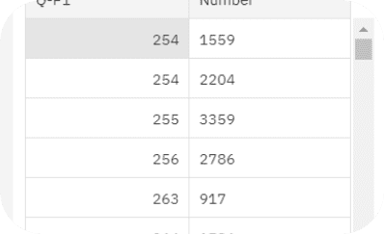
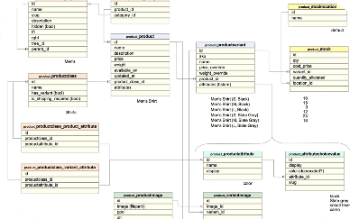
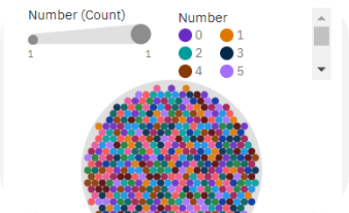
Data Collection
Transaction Records 📝
Product Information 📦
Customer Demographics 🧑‍🤝‍🧑
Capture transaction data such as customer details, date of purchase and product information to analyze sales patterns.
Gather product data such as stock keeping units (SKUs), prices, and descriptions to incorporate a qualitative aspect into our analysis.
Collect demographic information through surveys or other means to form a holistic view of customer behavior.

Slide 4

Visualizations Strategy
1
Interactive Dashboards 📊
2
Creatively Designed Reports 🎨
3
Ad Hoc Data Exploration ⚙️
Present data in dynamic and intuitive ways to invite data exploration and provide users with a comprehensive view of the sales data.
Allow users to design their own dashboards and reports and encourage user input to drive dynamic insights.
Visually appealing reports with custom designed graphics, charts and tables ensure easy comprehension and interpretation of insights.

Slide 5
Actionable Insights
1
Inventory Management 🧾
Gauge sales patterns to determine what to stock, when to stock and in what quantity. Avoid excess ordering or stock outs.
2
Marketing Strategies 📈
Develop targeted marketing campaigns that resonate with specific segments, identify areas to increase promotions and optimize cross-selling and upselling strategies.
3
New Product Development 🆕
Use insights to identify gaps in product lines, develop new products and adjust pricing strategies.

Slide 6
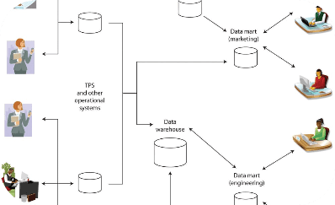

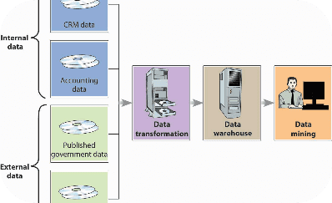
Clean and Format the Data
Data Warehouse 💾
Data Cleaning 🔍
Data Transformation 🛠️
Store clean product sales data in a data warehouse to ensure accurate and efficient use of data in analytics.
Check data quality to avoid inaccuracies, inconsistencies or duplications. Standardize fields for regular reporting.
Use data analysis tools to transform raw data into structured data that can be easily analyzed using IBM Cognos.

Slide 7
Exploratory Data Analysis
Product Mix Analysis 📊
Price Analysis 💰
Analyze the sale of different categories of products to better understand customer preferences and buying behavior.
Explore consumer price sensitivity and how it may affect sales. Adjust prices for optimized revenue.
Geographical Sales Analysis 🌍
Time Series Analysis 📅
Analyze the performance of products in different regions to assess the impact of location on sales.
Perform periodic analysis to interpret sales growth over time, identify cyclical trends and seasonal patterns etc.

Slide 8
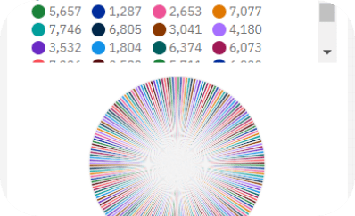

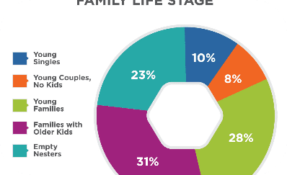
Predictive Modeling
Predictive Analytics 🤖
Machine Learning 🧠
Customer Segmentation 🎯
Use data mining and predictive modeling techniques to forecast future sales and determine the likelihood of success in a given situation.
Utilize artificial intelligence to train neural networks to identify subtle patterns and forecast future trends with a higher level of accuracy.
Group customers into segments based on different demographic parameters to better understand buying behaviors and develop targeted strategies for each group.

Slide 9
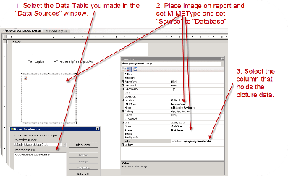
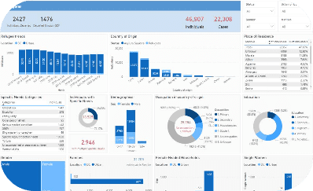
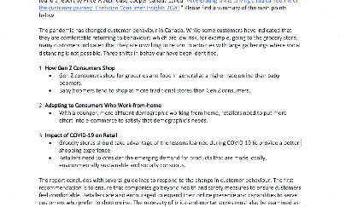
Reporting
PDF Reports 📑
Interactive Dashboards 📊
Email Reports 📧
Create PDF reports with customizable templates, automated schedules, and easy sharing for various stakeholders.
Create subscriptions for periodic reports to be automatically emailed to stakeholders. Ensure wide-spread accessibility of insights.
Create standalone dashboards with advanced visualizations for real-time insights. Allow stakeholders to drill down and focus on specific metrics.

Slide 10

Secure Data Access
1
Restricted Access 🔓
2
Authentication and Authorization 🔐
Ensure data privacy and security by creating user and role-based access control with controlled sign-on and single sign-on features.
Enforce strict authentication policies, identify authentication protocols, and employ authorization for data access to prevent unauthorized data access.
3
Data Governance 🏦
Implement policies and procedures for effective data management and monitor adherence to these policies.

Slide 11
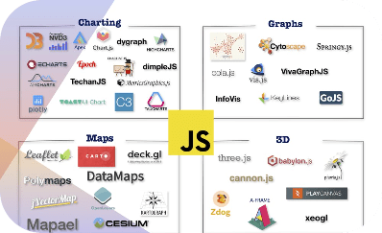

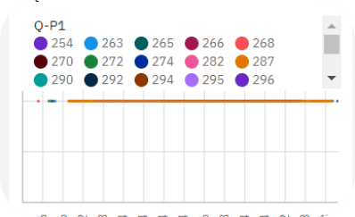
Implementation & Maintenance
IBM Cognos 🚀
Training and Collaboration 🤝
Performance Monitoring 📉
Deploy the visualization and analysis tools with proper resources and infrastructure for easy accessibility.
Train teams on operational processes and tools and work together to optimize performance through feedback and communication.
Monitor dashboards for performance deterioration, system health, and ensure proper maintenance and upgrades.

Slide 12
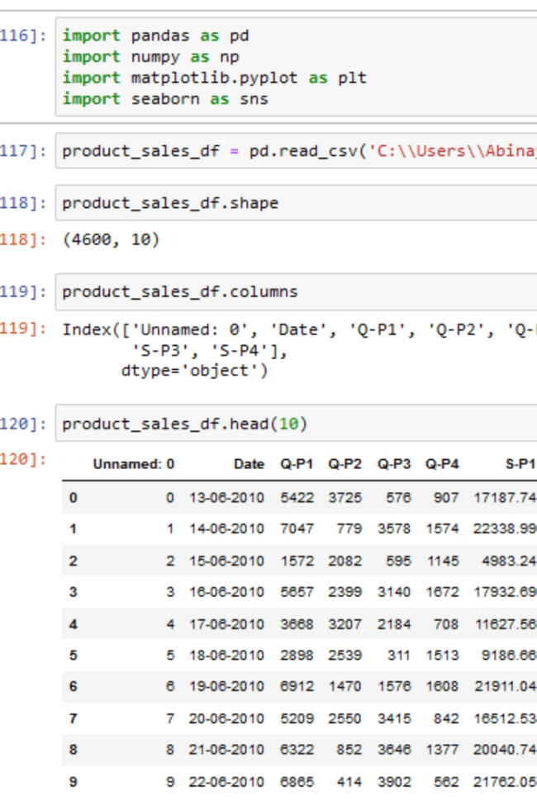
Data Extraction in Jupyter Notebook:
Data Extraction is the process of extracting data from various sources such as CSV files, web, PDF, etc. Although in some files, data can be extracted easily as in CSV, while in files like unstructured PDFs we have to perform additional tasks to extract data from PDF Python.

Slide 13
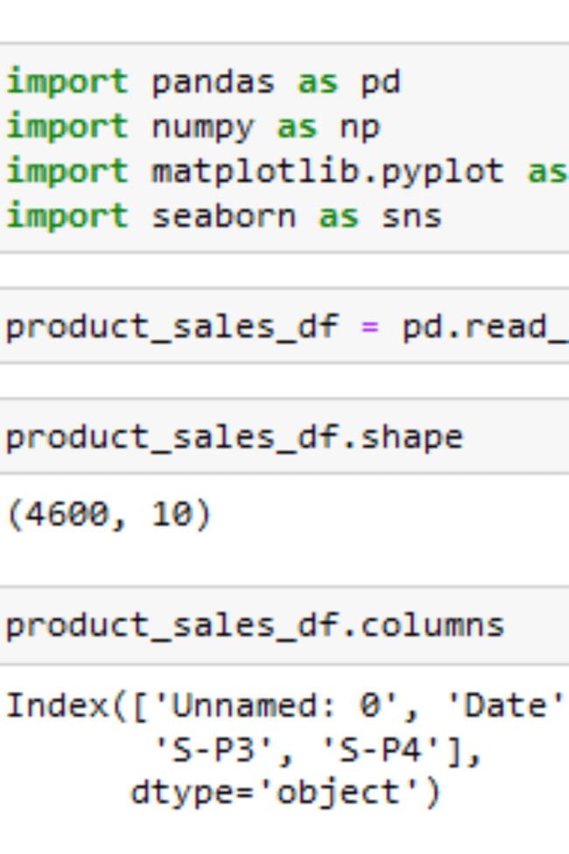
NumPy:
NumPy stands for Numerical Python, and it is a fundamental package for scientific computing in Python. NumPy provides an efficient interface to store and manipulate large arrays and matrices of homogeneous data, such as numbers or characters. NumPy is built on top of the Python programming language and integrates well with other scientific computing libraries, such as SciPy, Matplotlib, Pandas, and Scikit-learn

Slide 14
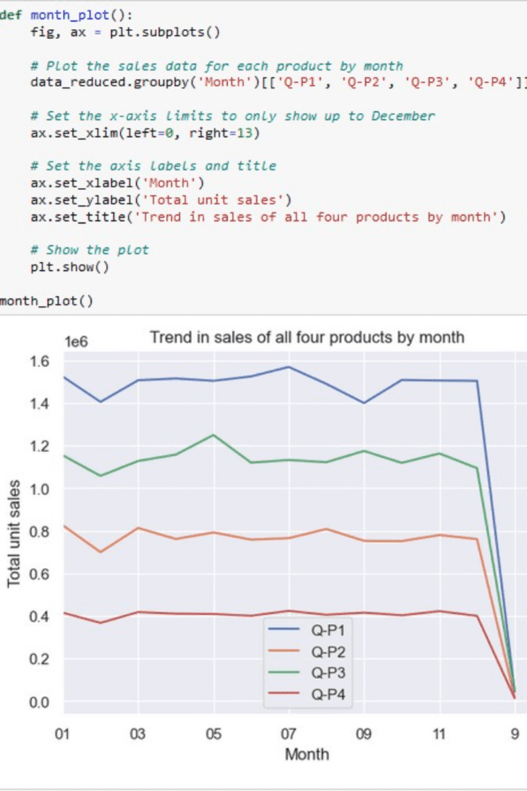
Pandas:
Pandas DataFrame is two-dimensional size-mutable, potentially heterogeneous tabular data structure with labeled axes (rows and columns). A Data frame is a two-dimensional data structure, i.e., data is aligned in a tabular fashion in rows and columns. Pandas DataFrame consists of three principal components, the data, rows, and columns

Slide 15
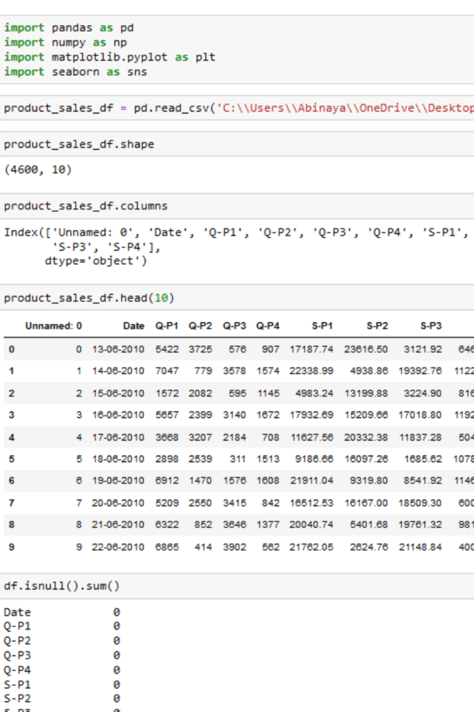
Matplotlib:
Matplotlib is an amazing visualization library in Python for 2D plots of arrays. Matplotlib is a multi-platform data visualization library built on NumPy arrays and designed to work with the broader SciPy stack. It was introduced by John Hunter in the year 2002. One of the greatest benefits of visualization is that it allows us visual access to huge amounts of data in easily digestible visuals. Matplotlib consists of several plots like line, bar, scatter, histogram etc

Slide 16
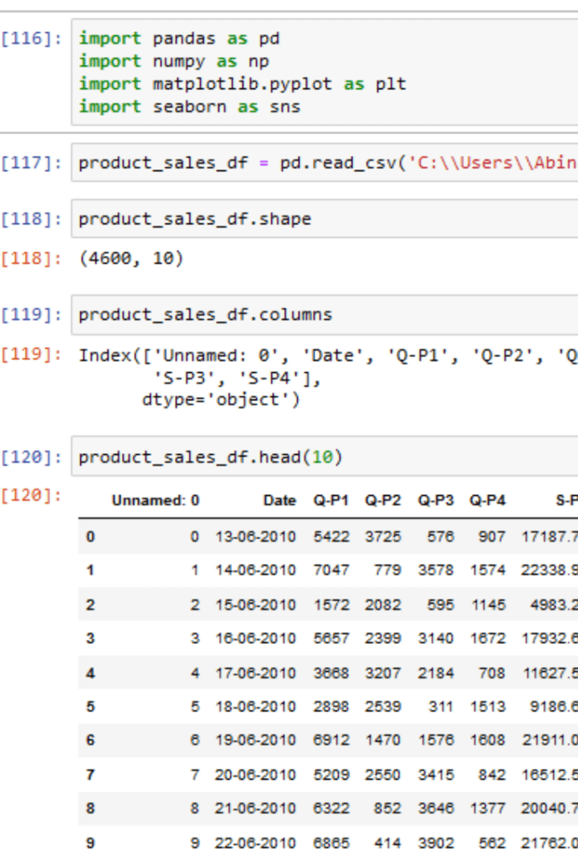
Random Forest Algorithm:
A random forest is a machine learning algorithm used for both classification and regression tasks. It is an ensemble learning method, which means it combines the predictions of multiple individual models to make more accurate predictions than any single model. The individual models in a random forest are typically decision trees

Slide 17
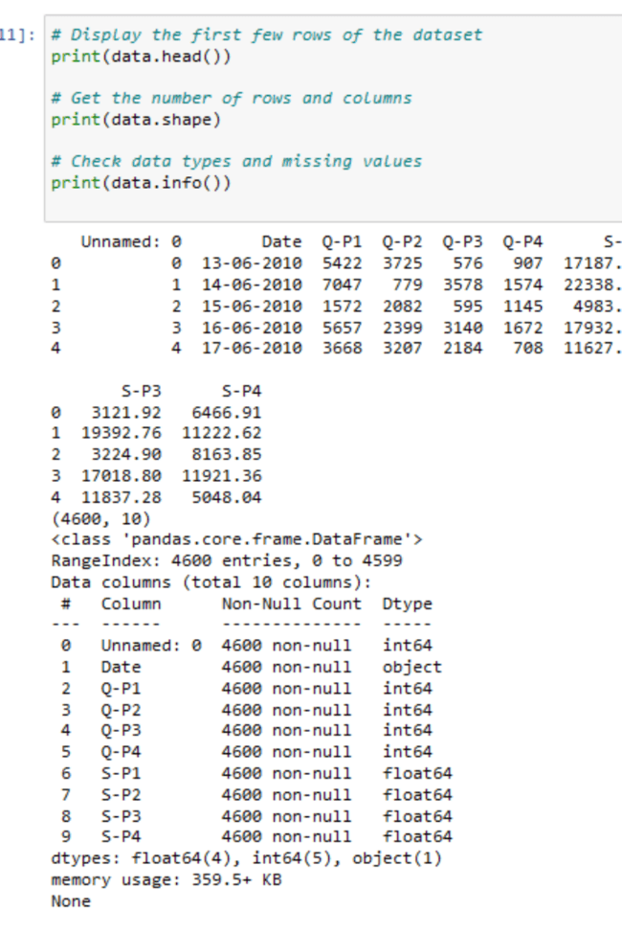
K-Nearest Neighbors (KNN):
K-Nearest Neighbors (KNN) is a simple and intuitive supervised machine learning algorithm used for both classification and regression tasks. It is a type of instance-based learning, where the algorithm doesn't learn an explicit model during training but instead memorizes the entire training dataset. KNN is based on the idea that objects (data points) with similar characteristics tend to be near each other in the feature space.

Slide 18
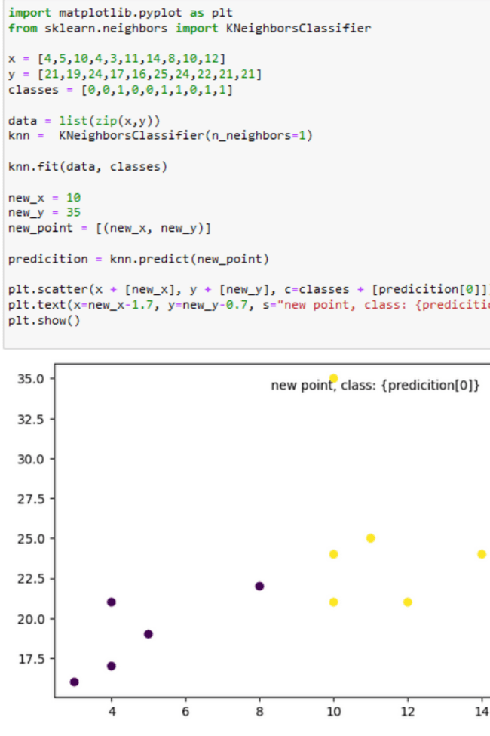
Gradient Descent Algorithm:
Gradient Descent is an optimization algorithm used to minimize or maximize functions, typically in the context of machine learning and deep learning. It is widely employed in training models, including linear regression, logistic regression, neural networks, and other types of models where the goal is to find the optimal set of parameters that minimizes a cost or loss function

Slide 19

Data Science:
Data science in Python involves using the Python programming language and various libraries and tools to analyze, manipulate, visualize, and make predictions from data. It is a multidisciplinary field that combines techniques from statistics, computer science, and domain-specific knowledge to extract insights and value from data.

Slide 20

Conclusion
In conclusion, this phase sets the foundation for our Product Sale Analysis project. By following a structured design thinking approach, we will ensure that our analysis is guided by clear objectives, based on reliable data, effectively communicated through visualization, and ultimately leads to actionable recommendations. This project has the potential to significantly benefit businesses by enhancing their understanding of sales trends and customer behavior.

